Slide 1
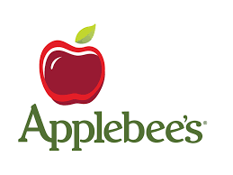
Capstone Project
MIS 670

Slide 2
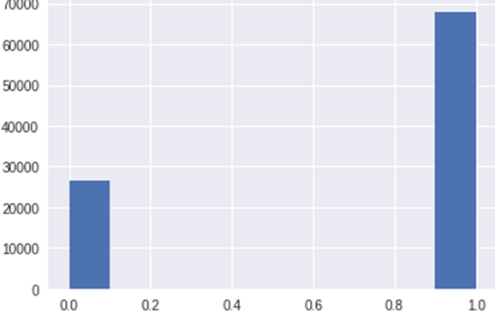
Retweet Histogram
Roughly 95,000 tweets
0 = Original Tweets
1 = Retweets
A histogram is an accurate representation of the distribution of numerical data.
72% of data are retweets
~68,000 tweets
28% of data are original
~27,000 tweets

Slide 3
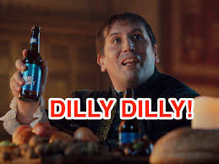
Important Social Media Topics
These are some promotions being talked about on the “Twittersphere”
Promotions:
Veterans Day
Holiday Gift Cards
Dilly Dilly Bud Light
October Drink of the Month
December Drink of the Month – “Dollar Jolly” Vodka Drink

Slide 4

Top Hashtags
#Sweepstakes
#Yelp
#Veterans
Other mentionable hashtags:
#datenight – suggesting a couples night
#fundraiser
#JackDaniels

Slide 5
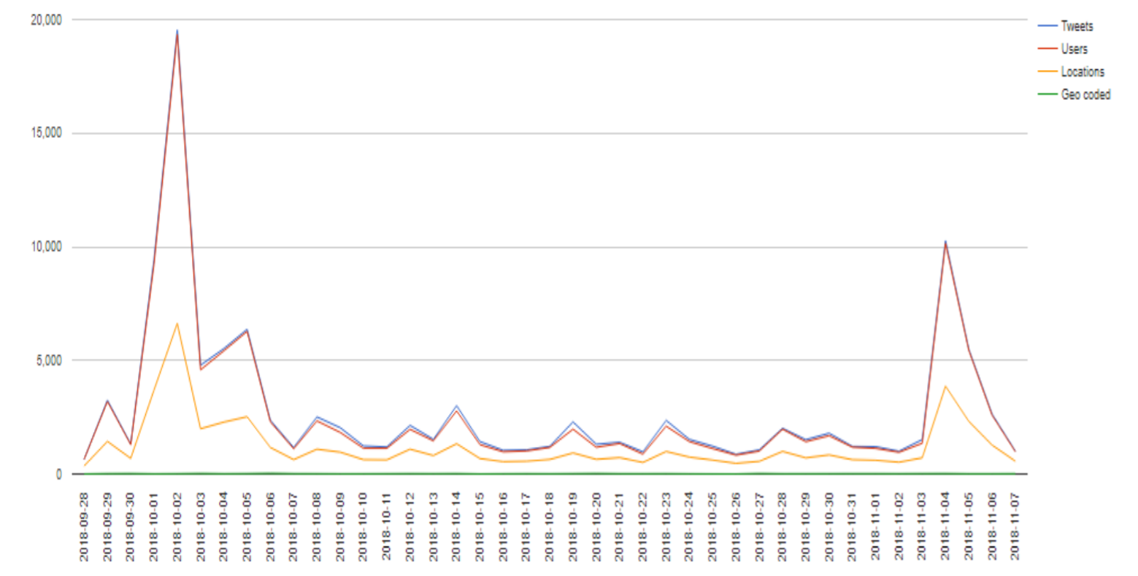
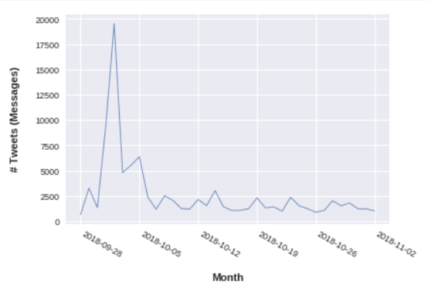
Spikes in Twitter Activity: What Happened?
Huge uptick in Twitter activity
~ 10/01 and 11/04

Slide 6
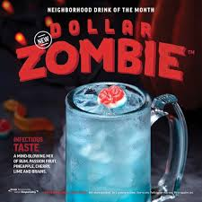
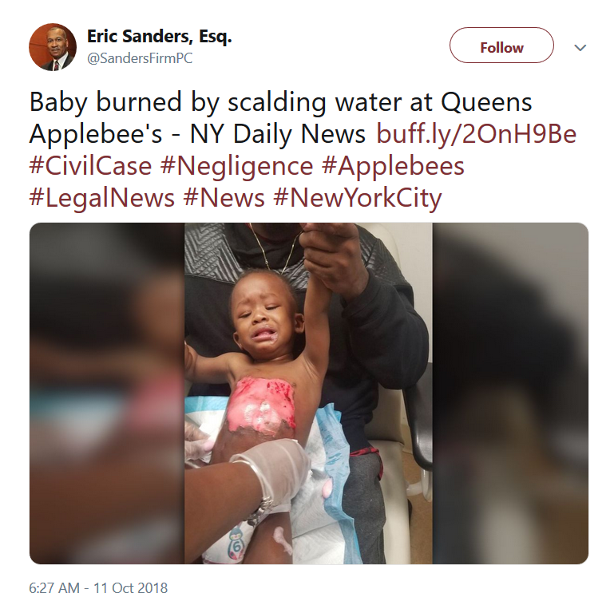
Spikes in Twitter Activity - This Happened!
Samuel Adams Octoberfest promotion – announced the first of October
$1 Zombie Margaritas – October 2nd (around 20,000 tweets that day about it)
Baby burned by scalding water - October 11th
November 4th - Stressed Customers
Articles surfaced about cheap alcohol and food
https://wkow.com/news/wakeup/2018/11/04/stress-eaters-responsible-for-applebees-sales-jump/

Slide 7
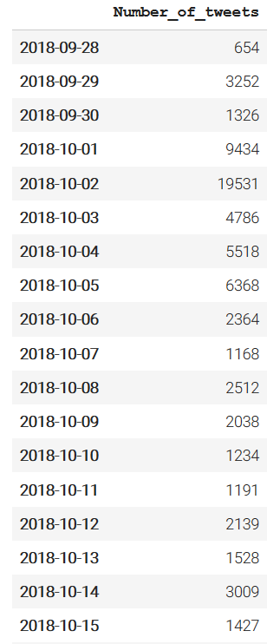
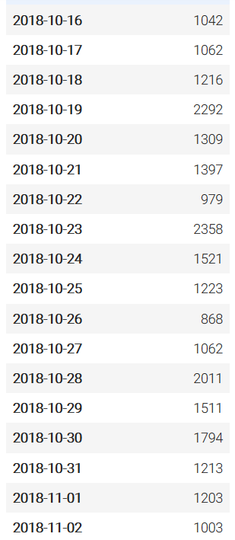
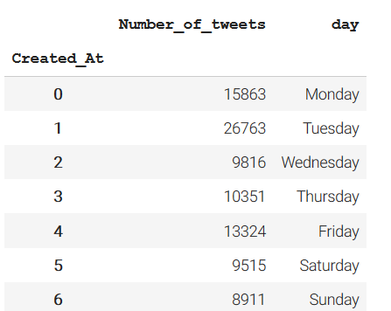
Total Number of Tweets Per Day 9/28 – 11/02
We are able to analyze tweets about Applebee’s each day, and be informed of spikes in twitter activity.

Slide 8
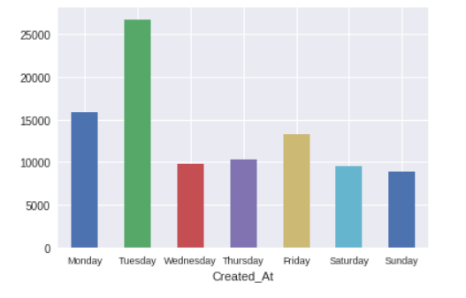
Total Number of Tweets Per Day 9/28 – 11/02

Slide 9
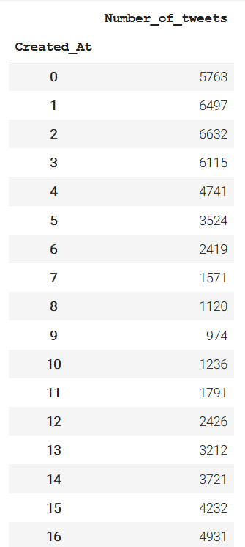
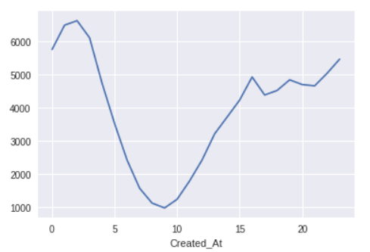
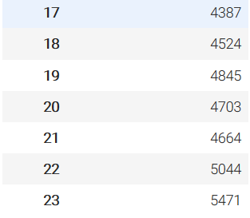
Hourly Number of Tweets
Users tweet about Applebee’s the most in the evening, specifically late at night.
Peak Hours
Closing time: 12:30 am ~ 2 am
Happy Hour: 3-6 pm
Late Night Happy Hour: 9-Midnight

Slide 10
Sentiment Analysis
Bing Liu
Analyzed around 500 original tweets
21% positive
10% negative
69% neutral
Pattern
Same data
25% positive
6% negative
69% neutral

Slide 11
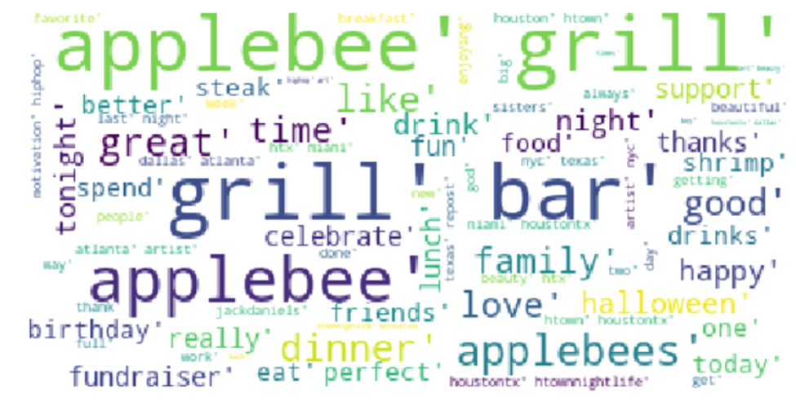
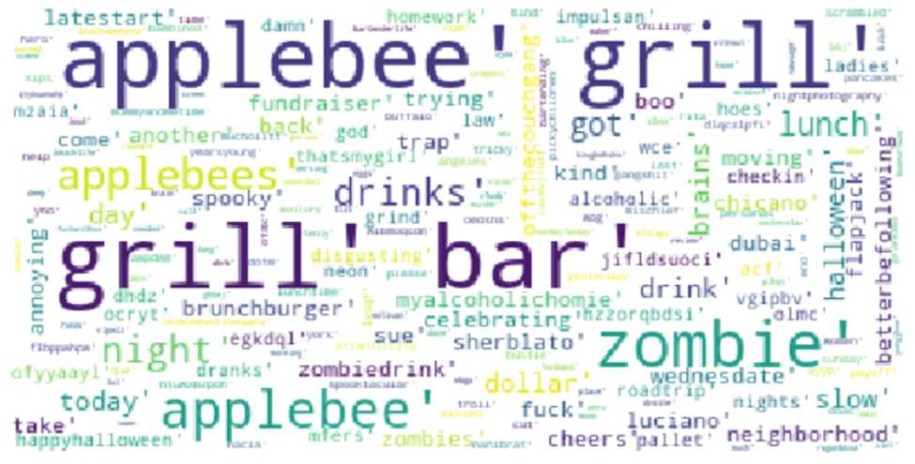
WordCloud Data
Negative WordCloud
Positive WordCloud

Slide 12

Mention Frequency
@TheOnion – New Ad Urges Hipsters To Go To Applebee’s Ironically
Joke items added to the menu:
Fajita Cordon Bleu
Chicken Strip Explosion
https://www.youtube.com/watch?v=tpSo-VJTeE8
Mentioning UFC/MMA fights to be watched at Applebee’s (Jonny Bones Jones/Colby Covington fight) – Jokes about fighters putting steroids in food
More Political Mentions: Sean Hannity, Sen. Lindsey Graham dining alone instead of facing the protestors
https://politics.theonion.com/lindsey-graham-dining-alone-at-applebee-s-kind-of-wishe-1829390273

Slide 13
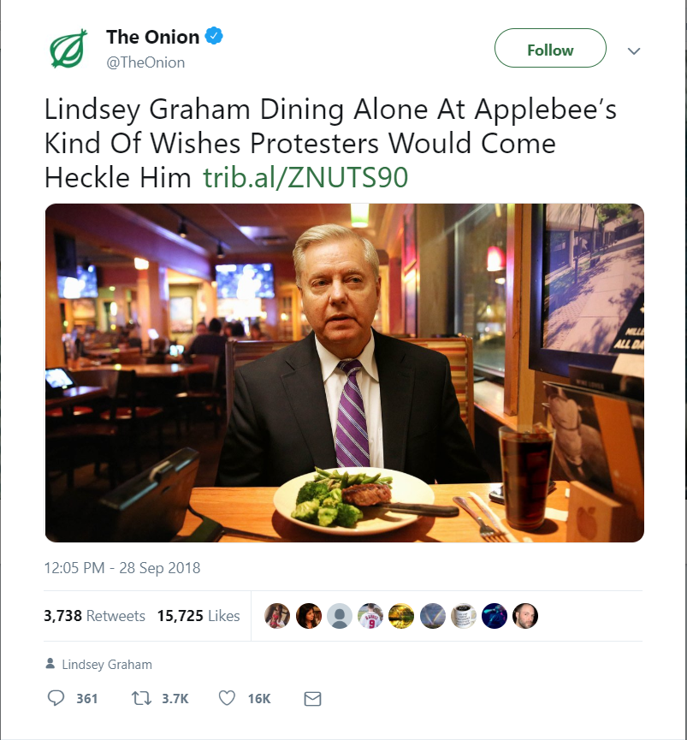
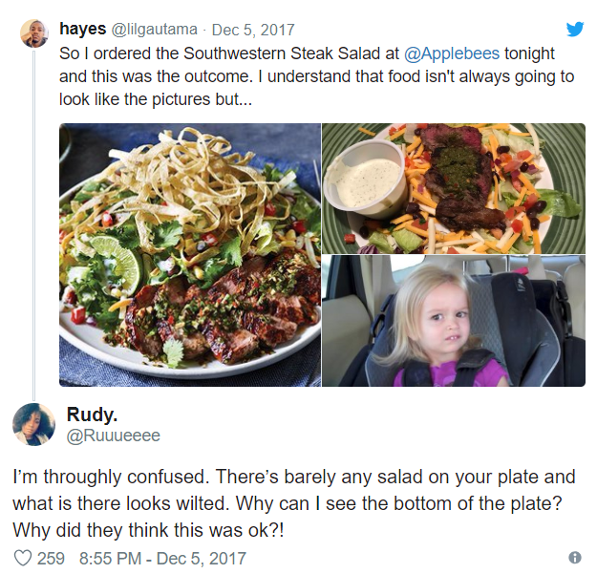

Slide 14

Local Applebee’s
#Yelp was a common hashtag
Over 50% of our local Applebee’s reviews from yelp give a one-star review
Combination of bad service and bad food presentation

Slide 15
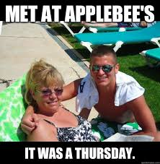
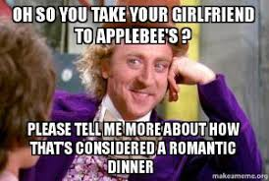
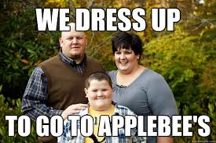
Applebee’s Online Reputation
Lots of profanity around tweets about Applebee’s
Users commonly pair Applebee’s and politics in a negative
manor
People tend to speak about Applebee’s jokingly
There is a common trend between promotion announcements and spikes in Twitter activity
Focus more on Yelp review reputation
Food presentation and overall service needs improvement
Happy Hour is a frequently mentioned promotion on Twitter

